Slide 1
MINI PROJECT
TEAM MEMBERS :
ANUBAMA.G
HARITHAA.G
JAVAJI SOWJANYA.J
KARPAGATHARENI.S

Slide 2
ARTICLE READER

Slide 3
PROBLEM STATEMENT
WHAT SHALL WE DO WHEN WE WANT TO READ AN ARTICLE OR STORY BUT WE HAVE LIMITED TIME ?
WHAT IF WE COULDN’T READ , BUT WE WANNA KNOW THE CONTENTS..?
SOMETIMES WE NEED TO GIVE REST TO OUR EYES BUT STILL WE NEED TO LEARN SOMETHING…

Slide 4
ARTICLE READER:
Article reader is a voice technology that reads a text file to the user
It is a software project that allows even the visually challenged to read and understand various documents

Slide 5
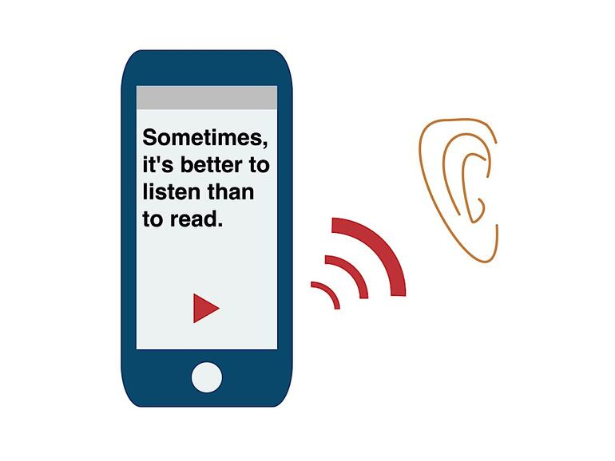

Slide 6

LANGUAGE USED :
JAVA

Slide 7
1.Designing a login page
Each user will be given a unique user id and password. In this module we have designed a code which accepts the user input(user id and password) and checks it.
If it is a valid match then the user will be permitted in otherwise an alternate option for changing the password will be displayed

Slide 8
2. Fetching the Data
A part of our code will fetch the contents from the website by using the URL
We can paste the URL in our app so that we can read any article at any time

Slide 9
3. Converting text to speech
Our code will convert the text from the url into audio.Now the contents of the url will be read by the app
User can start and stop the audio at anytime
We can use this app only when there is an internet connection

Slide 10
Domain : app development
App development is the act or process by which a mobile app is developed for mobile devices, such as personal digital assistants, enterprise digital assistants or mobile phones.
These applications can be pre-installed on phones during manufacturing platforms, or delivered as web applications using server-side or client-side processing (e.g., JavaScript) to provide an "application-like" experience within a Web browser.

Slide 11
Activity_main.xml
<?xml version="1.0" encoding="utf-8"?> <androidx.constraintlayout.widget.ConstraintLayout xmlns:android="http://schemas.android.com/apk/res/android" xmlns:app="http://schemas.android.com/apk/res-auto" xmlns:tools="http://schemas.android.com/tools" android:layout_width="match_parent" android:layout_height="match_parent" tools:context=".MainActivity"> <ImageButton android:id="@+id/img2id" android:layout_width="wrap_content" android:layout_height="wrap_content" app:layout_constraintBottom_toBottomOf="parent" app:layout_constraintEnd_toEndOf="parent" app:layout_constraintHorizontal_bias="0.923" app:layout_constraintStart_toStartOf="parent" app:layout_constraintTop_toTopOf="parent" app:layout_constraintVertical_bias="0.348" app:srcCompat="@android:drawable/ic_menu_view" />

Slide 12
Contd..
<EditText android:id="@+id/passid" android:layout_width="293dp" android:layout_height="48dp" android:width="320dp" android:ems="10" android:inputType="textPassword" app:layout_constraintBottom_toBottomOf="parent" app:layout_constraintEnd_toEndOf="parent" app:layout_constraintHorizontal_bias="0.094" app:layout_constraintStart_toStartOf="parent" app:layout_constraintTop_toTopOf="parent" app:layout_constraintVertical_bias="0.352" /> <Button android:id="@+id/loginid" android:layout_width="wrap_content" android:layout_height="wrap_content" android:text="login" app:layout_constraintBottom_toBottomOf="parent" app:layout_constraintEnd_toEndOf="parent" app:layout_constraintHorizontal_bias="0.049" app:layout_constraintStart_toStartOf="parent" app:layout_constraintTop_toTopOf="parent" app:layout_constraintVertical_bias="0.461" />

Slide 13
Contd..
<EditText android:id="@+id/userid" android:layout_width="292dp" android:layout_height="51dp" android:ems="10" android:inputType="textPassword" app:layout_constraintBottom_toBottomOf="parent" app:layout_constraintEnd_toEndOf="parent" app:layout_constraintHorizontal_bias="0.105" app:layout_constraintStart_toStartOf="parent" app:layout_constraintTop_toTopOf="parent" app:layout_constraintVertical_bias="0.235" /> <ImageButton android:id="@+id/img1id" android:layout_width="wrap_content" android:layout_height="wrap_content" app:layout_constraintBottom_toBottomOf="parent" app:layout_constraintEnd_toEndOf="parent" app:layout_constraintHorizontal_bias="0.921" app:layout_constraintStart_toStartOf="parent" app:layout_constraintTop_toTopOf="parent" app:layout_constraintVertical_bias="0.235" app:srcCompat="@android:drawable/ic_menu_view" />

Slide 14
Activity_EntryPage.xml
<?xml version="1.0" encoding="utf-8"?> <androidx.constraintlayout.widget.ConstraintLayout xmlns:android="http://schemas.android.com/apk/res/android" xmlns:app="http://schemas.android.com/apk/res-auto" xmlns:tools="http://schemas.android.com/tools" android:layout_width="match_parent" android:layout_height="match_parent" tools:context=".EntryPage"> <ScrollView android:id="@+id/scrollView2" android:layout_width="412dp" android:layout_height="536dp" android:layout_marginTop="100dp" android:layout_marginBottom="49dp" android:scrollbars="vertical" app:layout_constraintBottom_toTopOf="@+id/btn_speak_id" app:layout_constraintEnd_toEndOf="parent" app:layout_constraintHorizontal_bias="1.0" app:layout_constraintStart_toStartOf="parent" app:layout_constraintTop_toTopOf="parent" app:layout_constraintVertical_bias="1.0">

Slide 15
Contd..
android:orientation="vertical"> <TextView android:id="@+id/tv_url_txt_id" android:layout_width="match_parent" android:layout_height="526dp" android:textSize="18sp" app:layout_constraintBottom_toBottomOf="parent" app:layout_constraintEnd_toEndOf="parent" app:layout_constraintHorizontal_bias="1.0" app:layout_constraintStart_toStartOf="parent" app:layout_constraintTop_toTopOf="parent" app:layout_constraintVertical_bias="0.247" /> </LinearLayout> </ScrollView> <Button android:id="@+id/btn_speak_id" android:layout_width="wrap_content" android:layout_height="wrap_content" android:layout_marginBottom="36dp" android:text="speak" app:layout_constraintBottom_toBottomOf="parent" app:layout_constraintEnd_toEndOf="parent" app:layout_constraintHorizontal_bias="0.263" app:layout_constraintStart_toStartOf="parent" />

Slide 16
Contd..
<EditText android:id="@+id/linkpaste_id" android:layout_width="375dp" android:layout_height="56dp" android:layout_marginTop="16dp" android:layout_marginBottom="31dp" android:ems="10" android:inputType="textPersonName" app:layout_constraintBottom_toTopOf="@+id/scrollView2" app:layout_constraintEnd_toEndOf="parent" app:layout_constraintHorizontal_bias="0.555" app:layout_constraintStart_toStartOf="parent" app:layout_constraintTop_toTopOf="parent" app:layout_constraintVertical_bias="0.303" /> <Button android:id="@+id/pause_id" android:layout_width="wrap_content" android:layout_height="wrap_content" android:layout_marginBottom="36dp" android:text="pause" app:layout_constraintBottom_toBottomOf="parent" app:layout_constraintEnd_toEndOf="parent" app:layout_constraintHorizontal_bias="0.517" app:layout_constraintStart_toEndOf="@+id/btn_speak_id" app:layout_constraintTop_toBottomOf="@+id/scrollView2" app:layout_constraintVertical_bias="1.0" />

Slide 17
Entry_Page.java
package com.example.webseech; import androidx.appcompat.app.AppCompatActivity; import android.graphics.Color; import android.os.AsyncTask; import android.os.Bundle; import android.speech.tts.TextToSpeech; import android.text.method.ScrollingMovementMethod; import android.view.View; import android.widget.Button; import android.widget.EditText; import android.widget.ImageButton; import android.widget.ImageView; import android.widget.Scroller; import android.widget.TextView; import android.widget.Toast; import org.jsoup.Jsoup; import org.jsoup.nodes.Document; import org.jsoup.nodes.Element;

Slide 18
Contd..
import java.util.Locale; import java.util.concurrent.TimeUnit; public class EntryPage extends AppCompatActivity { TextView tv_url_txt; EditText linkpaste; Button btn_speak,btn_pause; TextToSpeech mtts; //int cmd = 1; @Override protected void onCreate(Bundle savedInstanceState) { super.onCreate(savedInstanceState); setContentView(R.layout.activity_entry_page); tv_url_txt = (TextView)findViewById(R.id.tv_url_txt_id); btn_speak = (Button) findViewById(R.id.btn_speak_id); btn_pause = (Button) findViewById(R.id.pause_id); linkpaste = (EditText) findViewById(R.id.linkpaste_id); tv_url_txt.setMovementMethod(new ScrollingMovementMethod()); mtts = new TextToSpeech(EntryPage.this, new TextToSpeech.OnInitListener() { @Override public void onInit(int status) { if( status == TextToSpeech.SUCCESS) { mtts.setLanguage(Locale.US); } } });

Slide 19
Contd..
// tv_url_txt.setScroller(context); btn_speak.setOnClickListener(new View.OnClickListener() { @Override public void onClick(View view) { getBodyText(); // try{Thread.sleep(30);}catch(InterruptedException e){System.out.println(e);} //tv_url_txt.getText().toString().split("\\s+"); mtts.speak(tv_url_txt.getText().toString(), TextToSpeech.QUEUE_FLUSH, null); btn_pause.setOnClickListener(new View.OnClickListener() { @Override public void onClick(View v) { if(mtts.isSpeaking()) { mtts.stop(); // mtts.shutdown(); } else{ Toast.makeText(EntryPage.this, "Not speaking", Toast.LENGTH_SHORT).show(); } } });

Slide 20
Contd..
@Override protected void onPause() { if(mtts!= null || mtts.isSpeaking()) { mtts.stop(); // mtts.shutdown(); } super.onPause(); } private void getBodyText() { String weburl = linkpaste.getText().toString(); new Thread(new Runnable() { @Override public void run() { final StringBuilder builder = new StringBuilder(); try { String url=weburl;//your website url Document doc = (Document) Jsoup.connect(url).get(); Element body = doc.body(); builder.append(body.text());

Slide 21
Contd..
} catch (Exception e) { builder.append("Error : ").append(e.getMessage()).append("\n"); } runOnUiThread(new Runnable() { @Override public void run() { tv_url_txt.setText(builder.toString().substring(0,2000)); } }); } }).start(); } }

Slide 22
Main_Activity.java
package com.example.webseech; import androidx.appcompat.app.AppCompatActivity; import android.content.Intent; import android.os.Bundle; import android.text.method.HideReturnsTransformationMethod; import android.text.method.PasswordTransformationMethod; import android.view.View; import android.widget.Button; import android.widget.ImageButton; import android.widget.TextView; import android.widget.Toast; public class MainActivity extends AppCompatActivity implements View.OnClickListener { Button login; TextView user, pass; String uss, pss; ImageButton img1, img2; @Override protected void onCreate(Bundle savedInstanceState) { super.onCreate(savedInstanceState); setContentView(R.layout.activity_main);

Slide 23
Contd..
case R.id.img1id: if(user.getTransformationMethod().equals(PasswordTransformationMethod.getInstance())) { user.setTransformationMethod(HideReturnsTransformationMethod.getInstance()); } else { user.setTransformationMethod(PasswordTransformationMethod.getInstance()); } break; case R.id.img2id: if(pass.getTransformationMethod().equals(PasswordTransformationMethod.getInstance())) { pass.setTransformationMethod(HideReturnsTransformationMethod.getInstance()); } else { pass.setTransformationMethod(PasswordTransformationMethod.getInstance()); } break; } } }

Slide 24
Build_Gradle
// Top-level build file where you can add configuration options common to all sub-projects/modules. buildscript { repositories { google() jcenter() } dependencies { classpath "com.android.tools.build:gradle:4.1.2" // NOTE: Do not place your application dependencies here; they belong // in the individual module build.gradle files } } allprojects { repositories { google() jcenter() } } task clean(type: Delete) { delete rootProject.buildDir

Slide 25
Contd..
user = (TextView) findViewById(R.id.userid); pass = (TextView) findViewById(R.id.passid); login = (Button) findViewById(R.id.loginid); img1 = (ImageButton) findViewById(R.id.img1id); img2 = (ImageButton) findViewById(R.id.img2id); login.setOnClickListener(this); img1.setOnClickListener(this); img2.setOnClickListener(this); } @Override public void onClick(View v) { switch(v.getId()) { case R.id.loginid: uss= user.getText().toString(); pss= pass.getText().toString(); Toast.makeText(this, uss+" "+pss, Toast.LENGTH_SHORT).show(); if(uss.equals("admin") && pss.equals("12345")) { Intent intent = new Intent(MainActivity.this,EntryPage.class); startActivity(intent); }

Slide 26
Android_Manifest.xml
// Top-level build file where you can add configuration options common to all sub-projects/modules. buildscript { repositories { google() jcenter() } dependencies { classpath "com.android.tools.build:gradle:4.1.2" // NOTE: Do not place your application dependencies here; they belong // in the individual module build.gradle files } } allprojects { repositories { google() jcenter() } } task clean(type: Delete) { delete rootProject.buildDir }

Slide 27
Build.Gradle_app
plugins { id 'com.android.application' } android { compileSdkVersion 30 buildToolsVersion "30.0.3" defaultConfig { applicationId "com.example.webseech" minSdkVersion 16 targetSdkVersion 30 versionCode 1 versionName "1.0" testInstrumentationRunner "androidx.test.runner.AndroidJUnitRunner" } buildTypes { release { minifyEnabled false proguardFiles getDefaultProguardFile('proguard-android-optimize.txt'), 'proguard-rules.pro' } } compileOptions { sourceCompatibility JavaVersion.VERSION_1_8 targetCompatibility JavaVersion.VERSION_1_8 } }

Slide 28
Contd..
dependencies { implementation 'androidx.appcompat:appcompat:1.2.0' implementation 'com.google.android.material:material:1.3.0' implementation 'androidx.constraintlayout:constraintlayout:2.0.4' testImplementation 'junit:junit:4.+' implementation 'org.jsoup:jsoup:1.13.1' androidTestImplementation 'androidx.test.ext:junit:1.1.2' androidTestImplementation 'androidx.test.espresso:espresso-core:3.3.0' }

Slide 29
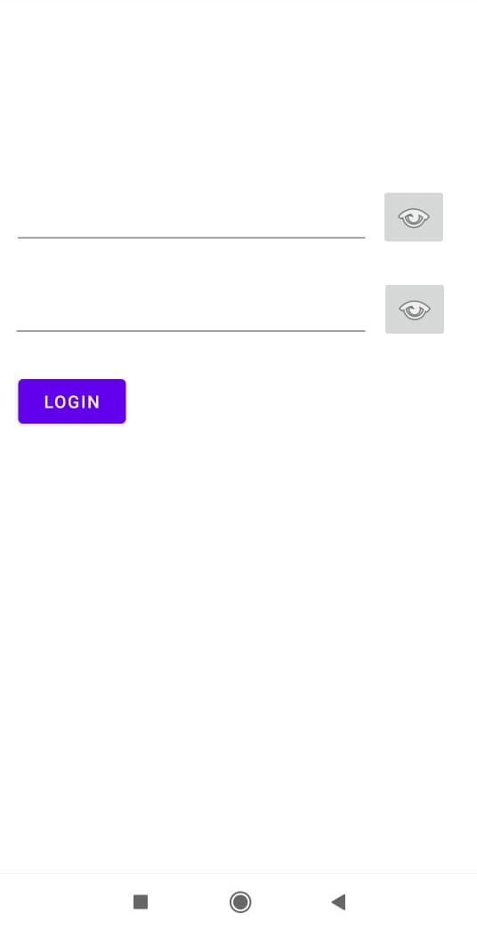
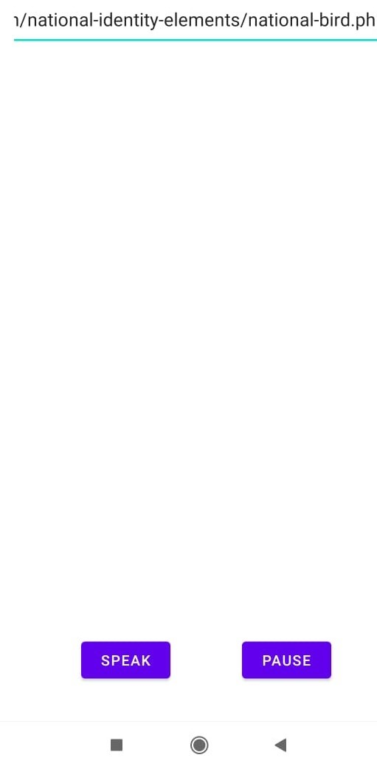
Screenshots of the app

Slide 30


